Slide 1
Day 1 – Canvas App

Slide 2
Content
Introduction to LCNC , Components of LCNC
LCNC vs Traditional Development
Different LCNC Platform/Tools/Applications
Introduction to Power Apps, Power Apps Building Blocks
Power App Interface overview and examples
Types of Apps (Canvas/Model-driven/Power Apps Portal)
Anatomy of Canvas app and Connectors
Execution Phases of Canvas App
Data Call Flow with online & on-premise data sources/Dataverse
Canvas App poor performance reasons and solution
Installation and Configuration (Practical)
Customize a canvas app in Power Apps (Practical)
Different controls, templates, screen types, Collections, Variables (Practical)
Explore different Connectors, Formulae, Screen/UI Navigation (Practical)
Create canvas app using Share point, office 365 connectors (Practical)

Slide 3
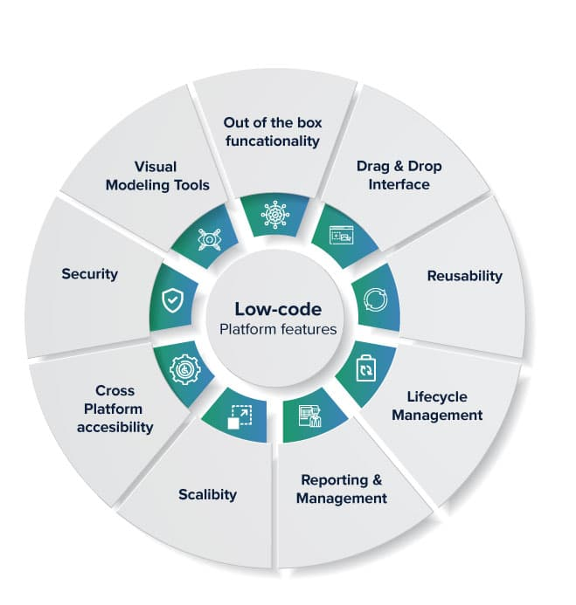
What is Low Code No Code
Platform that provides graphical user interface, templates and Pre-coded modules to develop application quickly where we require to write very less or no code.
These tools help in the fast development of code by minimizing hand-coding efforts. These platforms not only help with coding but also with the quick setup and deployment.

Slide 4
Components of LCNC
Interface Designer
Workflow Designer
Connectors
Common Database System

Slide 5
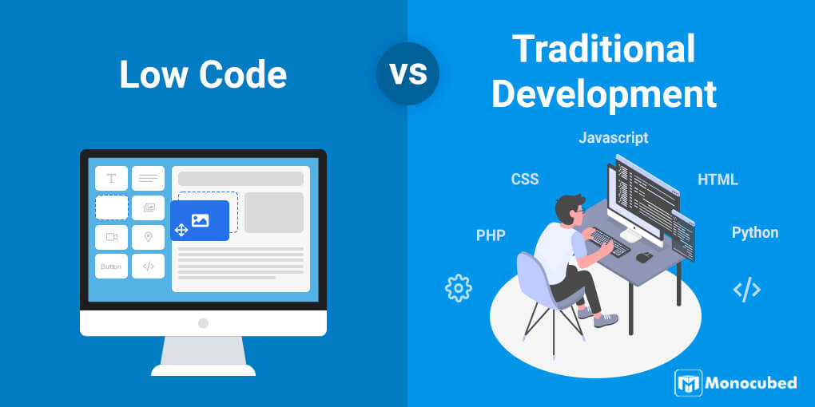

Slide 6
Property | Low Code Development | Traditional Development
Coding Knowledge | Minimum knowledge required. Low code developers require basic coding knowledge. | Professional web developers with advanced coding skills and knowledge of multiple web frameworks work with traditional web apps.
Speed of Development | Quick to develop . You can develop a working web app in just 1-3 weeks. | Time consuming and needs couple of months to make working app.
Deployment | Deploying low code apps is fast. But you have access to limited platforms. Depending on the low code tools you are using, you can deploy only to supported platforms. | With traditional web apps, you are free to deploy to any and all platforms.
Customization | Customization is limited | Customization is broader comparatively
Versioning | Versioning is limited and not reliable | Versioning can be achieved by external tools like visual studio, GIT, TFS etc
Team Strength | Most of the process is automated so small team can achieve required target | Require bigger team comparatively.
Quality | Integrability is limited Scalability is limited Performance and speed is standard With live debugging, the app is error-free | Integrable with all systems High scalability Performance and speed is extremely high Testing and debugging requires time
Cost | Cost to develop is cheaper | Expensive as it requires license for software's, tools, database, reports, servers and web space
Maintenance | Low code apps are easy maintenance comparatively. When the company updates the low code platform, your low code web apps will be automatically updated. So you spend minimal resources in the regular maintenance. | Custom-built web apps can be tough to regularly update and maintain. You need a dedicated team to update the code each time

Slide 7
LCNC Platforms
Microsoft Power Apps
Out System
Salesforce
Oracle Apex
Visual LANSA
Retool
Quixy
Creatio
Genxus
Zoho Creator
Web.com
Appian
App Sheet
Google App Maker
File Maker

Slide 8
Introduction to Power Apps
Power Apps is a suite of apps, services, connectors, and a data platform that provides you with an opportunity to build custom apps for your business needs.
By using Power Apps, you can quickly build custom business apps that connect to your business data that is stored either in the underlying data platform (Microsoft Dataverse) or in various online and on-premises data sources (SharePoint, Excel, Office 365, Dynamics 365, SQL Server, and so on).

Slide 9
Power Apps Building Blocks
Power Apps Home Page - Apps start here, whether you build them from data, a sample app, or a blank screen.
Power Apps Studio - Develop your apps further by connecting to data, adding and arranging user interface (UI) elements (known as controls), and building formulas.
Power Apps Mobile - Run your apps on Microsoft Windows, Apple iOS, and Google Android devices.
Power Apps Admin Center - Manage Power Apps environments and other components.

Slide 10
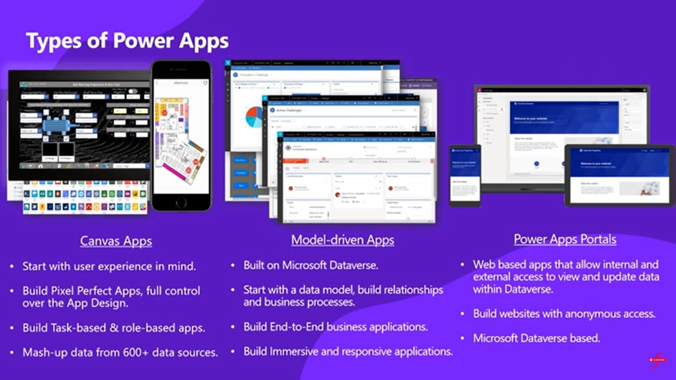

Slide 11
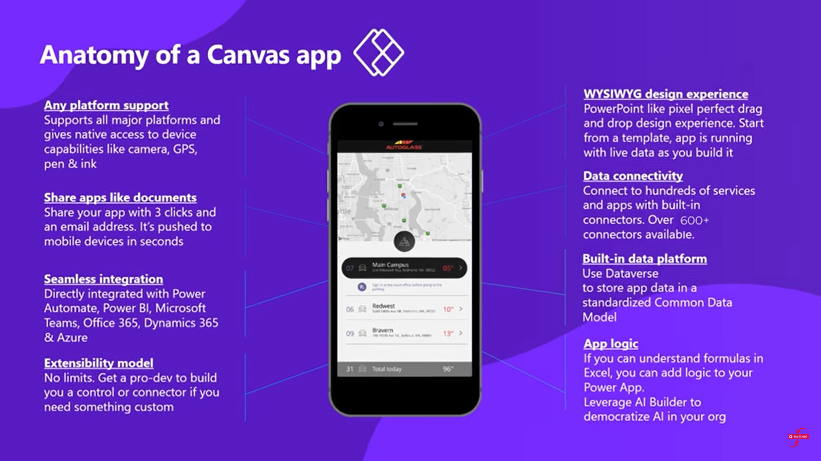

Slide 12
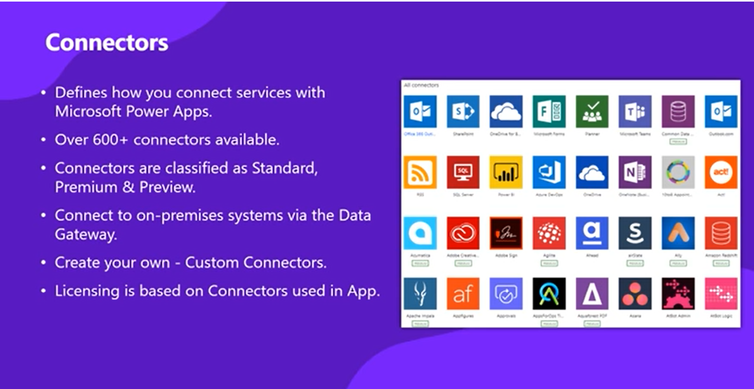

Slide 13
Execution Phases in Canvas App
A canvas app goes through the following phases of execution before showing the interface to a user:
Authenticate the user: Prompts the first-time user to sign in with credentials for whatever connections the app needs. If that user opens the app again, that person might be prompted again, depending on the organization's security policies.
Get metadata: Retrieves metadata, such as the version of the Power Apps platform on which the app runs and the sources from which it must retrieve data.
Initialize the app: Performs any tasks specified in the OnStart property.
Render the screens: Renders the first screen with controls that the app has populated with data. If the user opens other screens, the app renders them by using the same process.

Slide 14
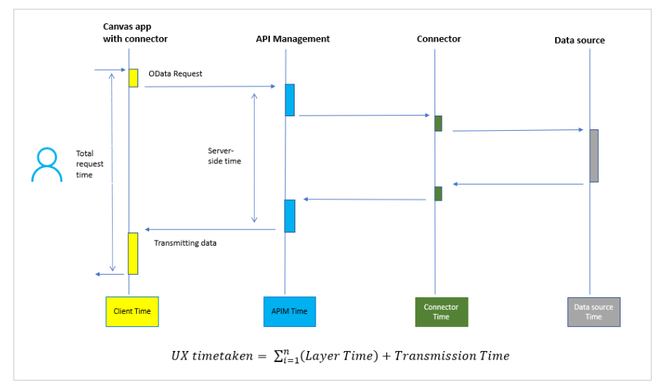
Data call flow with online data sources

Slide 15
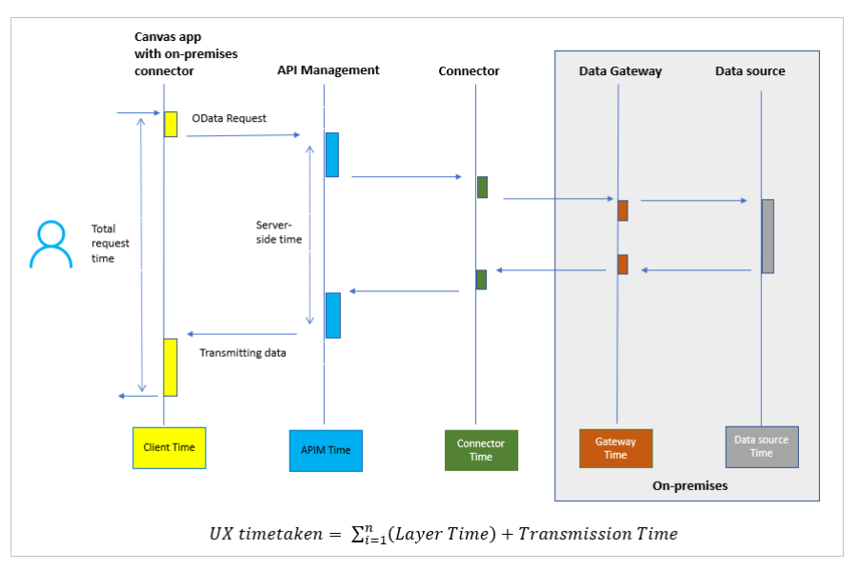
Data call flow with on-premises data gateway

Slide 16
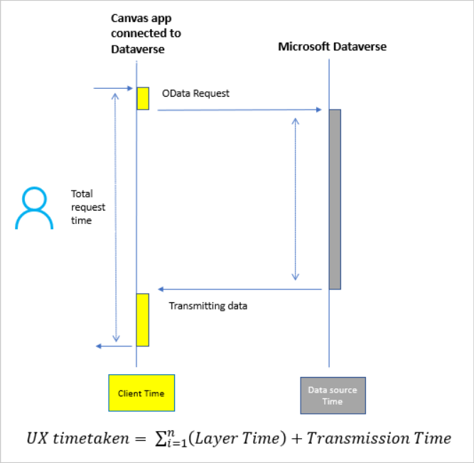
Data call flow with Microsoft Dataverse

Slide 17
Installation and Configuration of Power Apps (This is Practical demonstration)

Slide 18
Common Sources of Slow Performance of Canvas App
App Design
The app is client-heavy: The app gets large sets of data into data collections initially, and then uses the data within multiple screens over client-heavy operations like JOIN, Sort, Add Column, and Group By.
The app has a long formula in OnStart: The app triggers many unnecessary data calls in screens, and these data calls return large data records.
Bottleneck in the data source
There are many possible causes of bottlenecks in the data source. Usually, tables in the data source are at the center of activity when many transactional/nontransactional queries are directed to the same table or record from different users.
OData calls might slow down if:
The back-end machine hosting the data source is low on resources.
The back-end SQL instance has blockings, deadlocks, or resource contention.
The on-premises data gateway is unhealthy.
Geographical location of the on-premises data gateway and environment
Temporary throttling of high-volume requests at the back end
Debug published app setting enabled

Slide 19
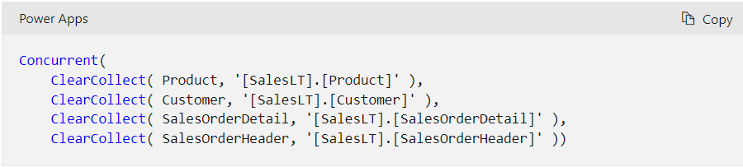
Tips and best practices to improve performance of canvas apps
Limit Data Connections
Don’t add more than 30 connections per app
Limit number of Controls
Don’t add more than 500 controls in one app. Power Apps generates an HTML document object model to render each control. The more controls you add, the more generation time Power Apps needs.
Optimize the OnStart Property
Use ClearCollect and Concurrent functions while loading collections on Start

Slide 20
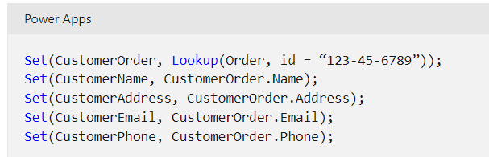
Tips and best practices to improve performance of canvas apps(Continued)
Cache Lookup Data
Use the Set function to cache data from lookup tables locally to avoid repeatedly retrieving data from the source. This technique optimizes performance if the data probably won't change during a session. As shown in the following example, the data is retrieved from the source once, and then referenced locally until the user closes the app
Avoid control dependency between screens
To improve performance, the screens of an app are loaded into memory only as they're needed. This optimization can be hampered if, for example, screen 1 is loaded and one of its formulas uses the property of a control from screen 2. Now screen 2 must be loaded to fulfill the dependency before screen 1 can be displayed. Imagine screen 2 has a dependency on screen 3, which has another

Slide 21
Thank You

